Slide 1
Interactive Sales & Profit Dashboard
Summary for Business Stakeholders
Developed using Power BI with regional and category slicers for detailed insights
Prepared by: Dalia Nashaat

Slide 2
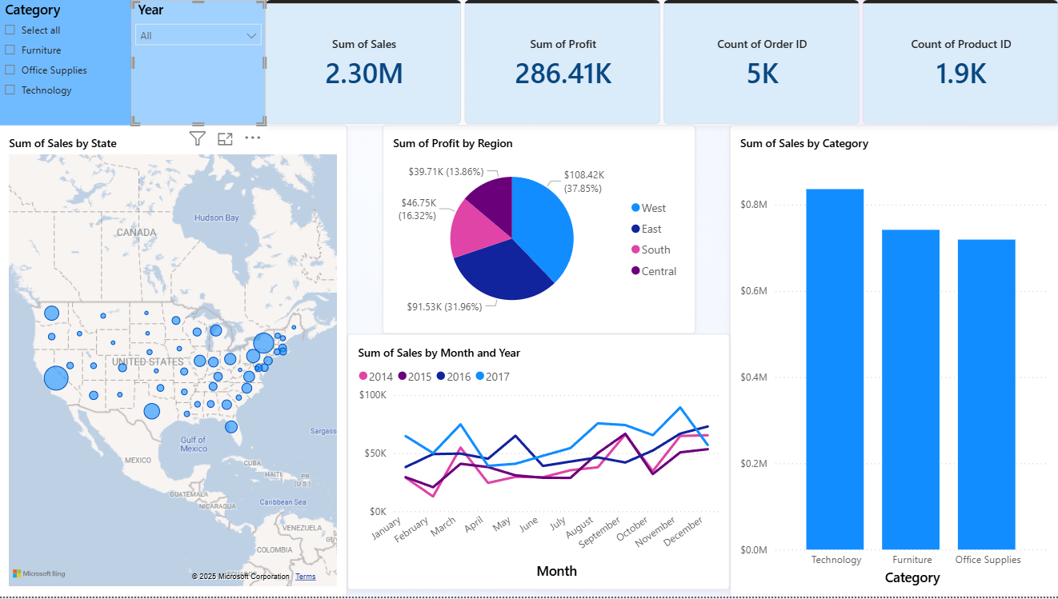
Overall Dashboard View – All Regions.

Slide 3
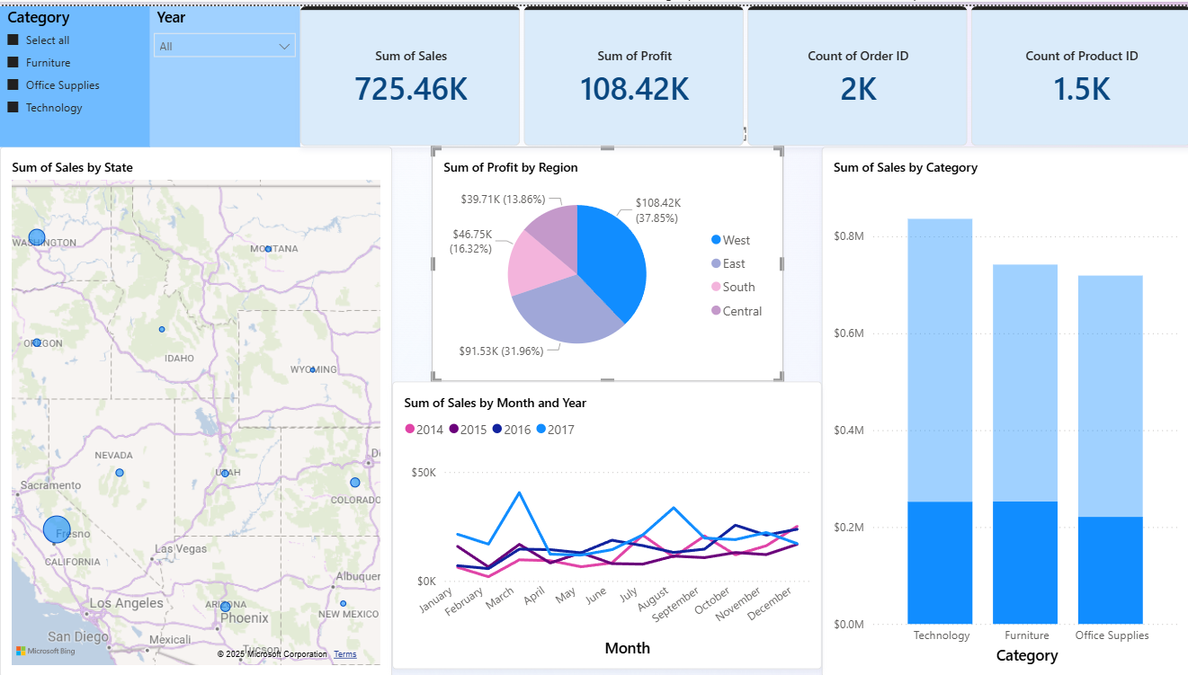
West Region
California dominates sales and profit in the West region.
Technology and Furniture have similar sales, both ahead of Office Supplies.

Slide 4
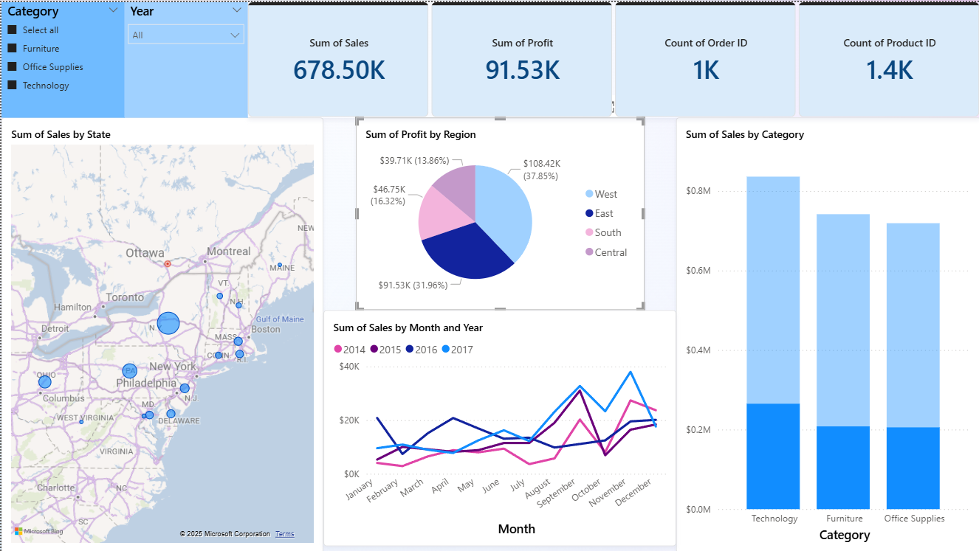
East Region
New York leads sales in the East region.
Technology is the top-selling category, followed by Furniture and Office Supplies.

Slide 5
Key Takeaways & Recommendations
Key Takeaways:
California and New York record the highest sales overall.
West region: Technology and Furniture sales are almost equal, both above Office Supplies.
East region: Technology leads sales, with Office Supplies outperforming Furniture.
Profit distribution aligns with sales trends in most cases.
Recommendations:
Focus marketing and inventory on Technology products in all regions.
Explore strategies to boost Office Supplies sales in the West.
Leverage strong California and New York markets for new product launches.

